Slide 1
A (very) brief overview of 50 years of Goddard Colloquia
compiled and presented by Hans Krimm, Code 661
1635 Talks over 50 years

Slide 2
Percentage of female speakers by decade
50 years : 1635 talks
1343 unique speakers
169 local (GSFC) speakers
157 repeat speakers:
101 spoke twice
37 spoke three times
15 spoke four times
4 spoke five times:
Lennard Fisk (GSFC/NASA HQ/Michigan)
Paul Lowman (GSFC)
Eugene Parker (U. Chicago)
Ed Stone (Cal Tech)

Slide 3
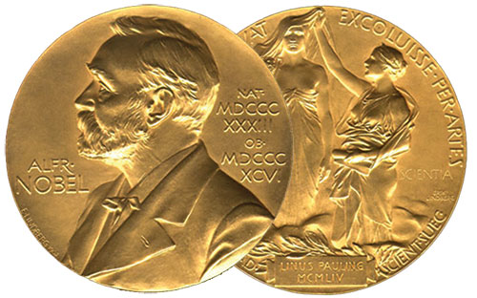
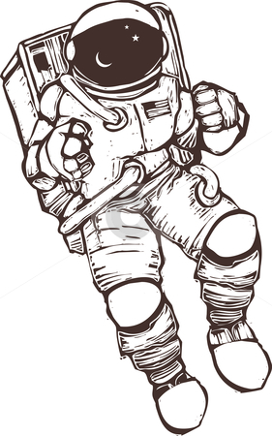
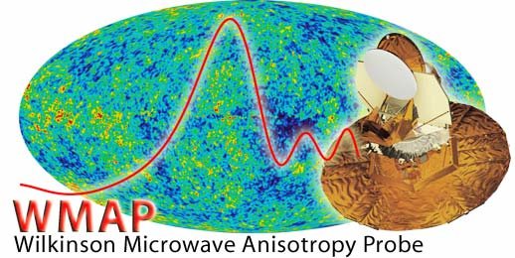
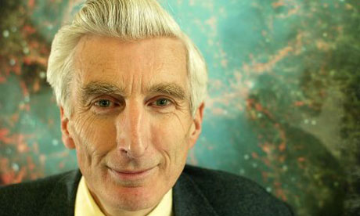
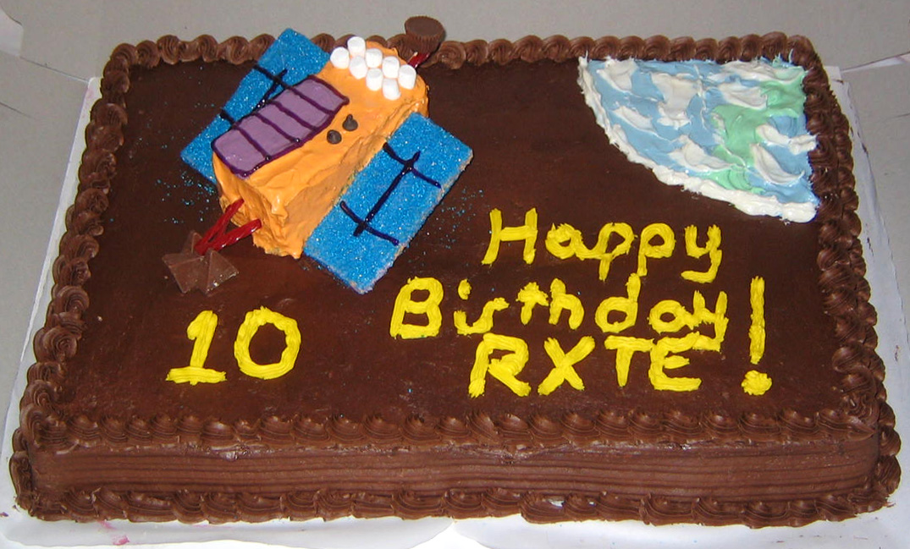
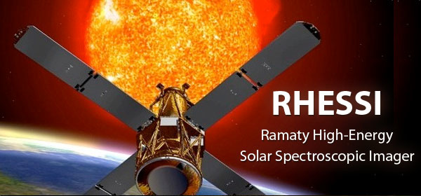
582 (of 1343) have Wikipedia pages
~33% of past speakers are deceased
7 Astronauts
(one, Harrison Schmidt,
also a former Senator)
36 Nobel Laureates
27 Physics
7 Chemistry
1 Medicine
1 Economics
(+ several climate scientists on
The Intergovernmental Panel on Climate Change, which shared Nobel Peace Prize)
Too many to list MacArthur, Fullbright, Guggenheim, National Medal of Science, Kavli, NASA Distinguished Service, etc.
Rossi
One Astronomer Royal (Sir Martin Reese)

Slide 4
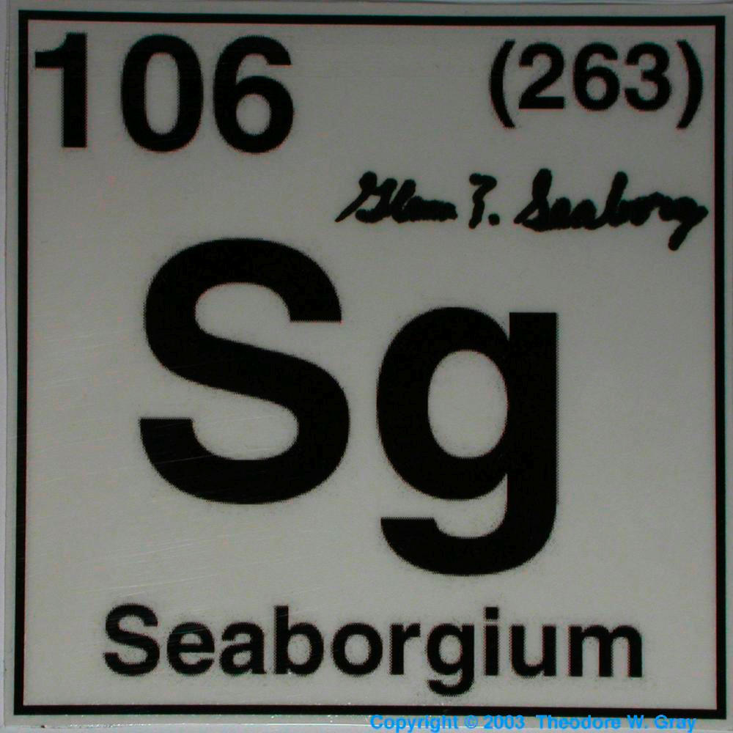
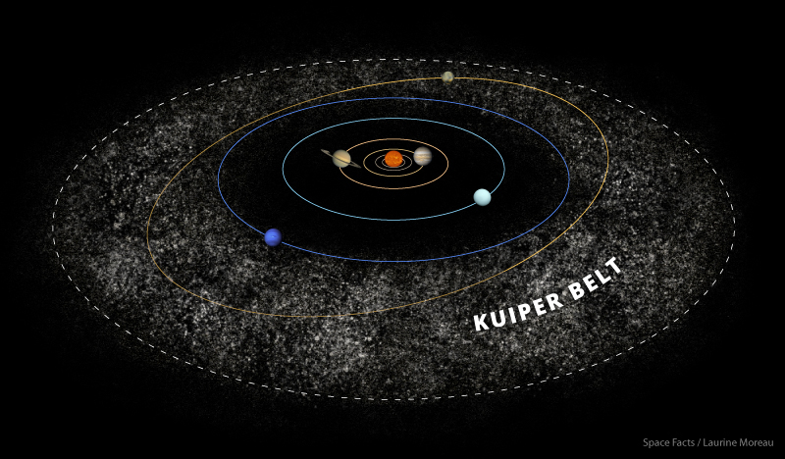
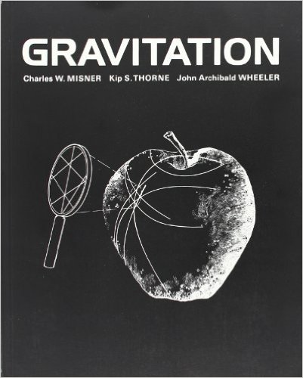
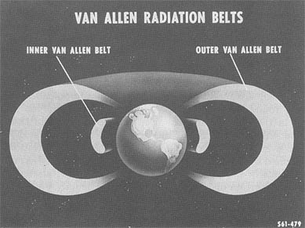
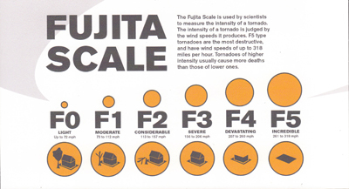
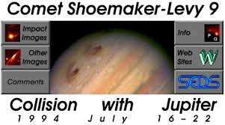
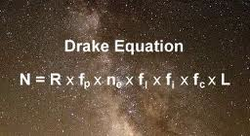

Slide 5
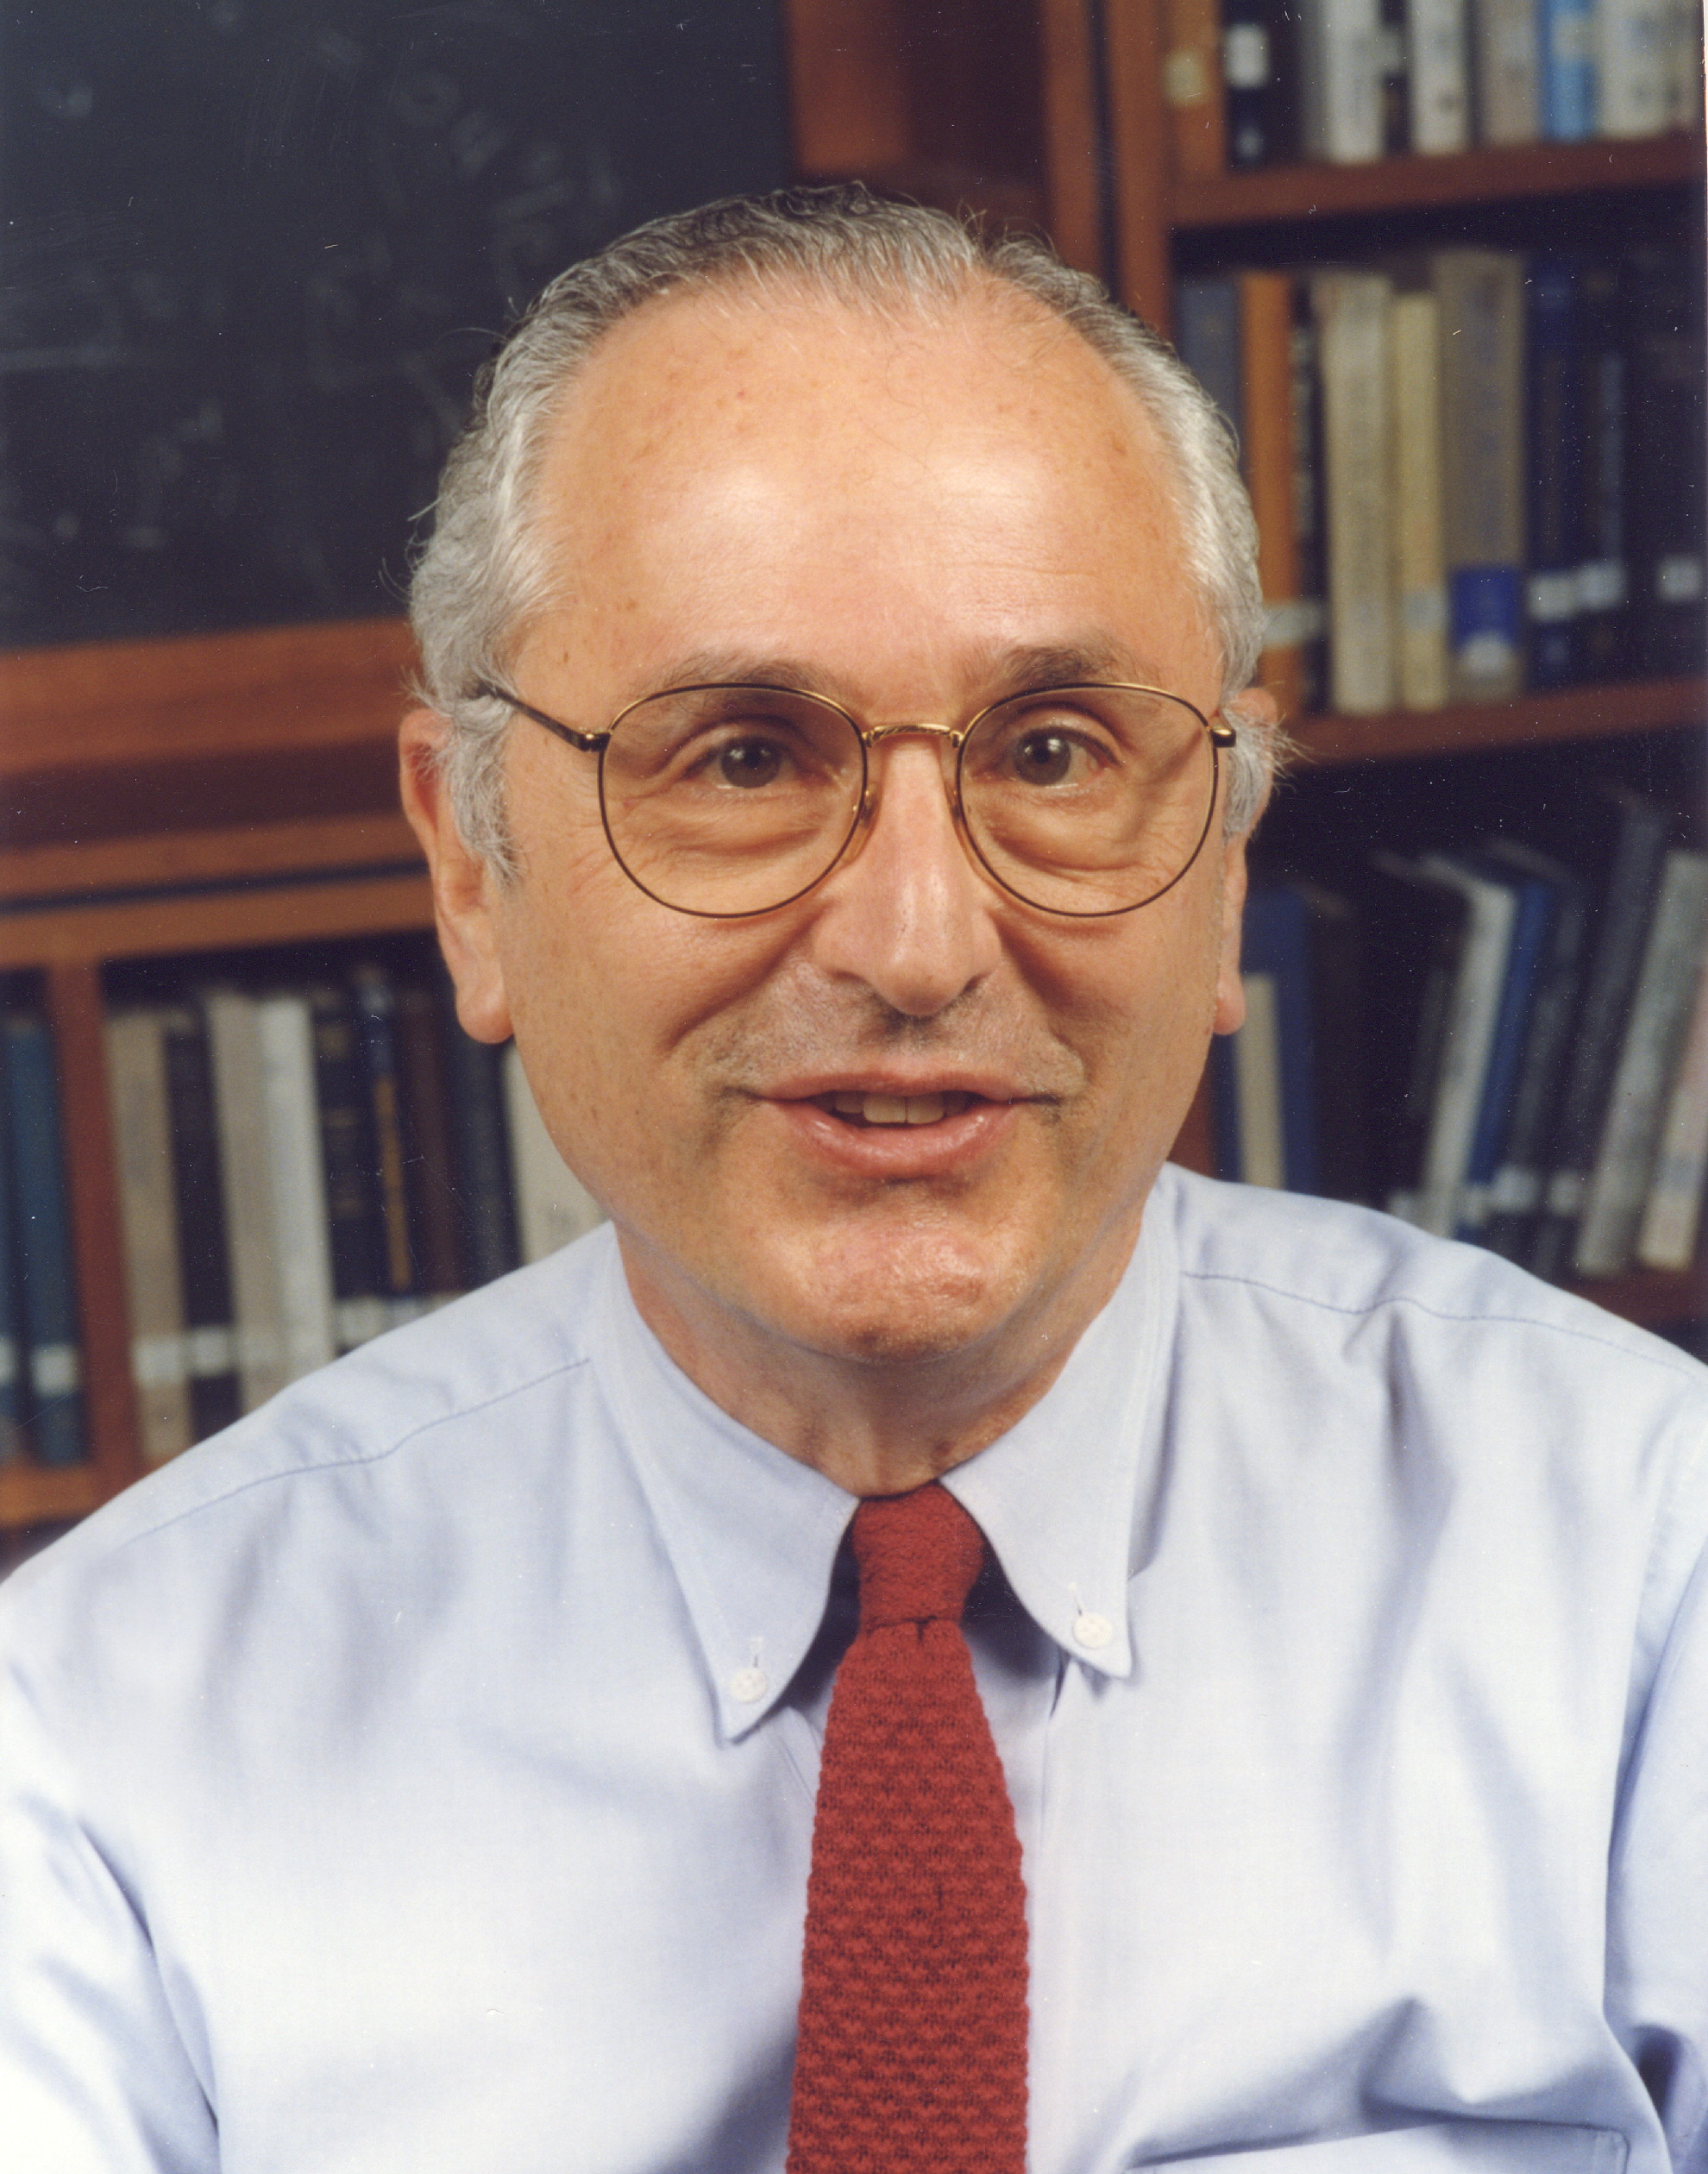
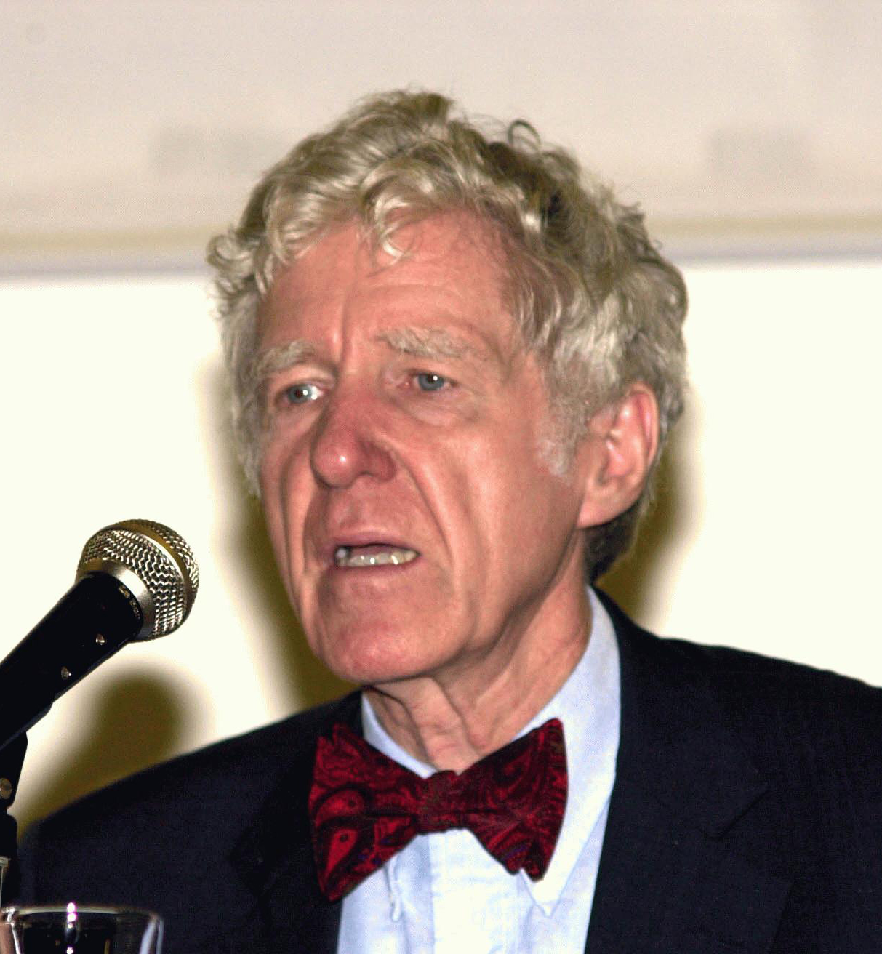
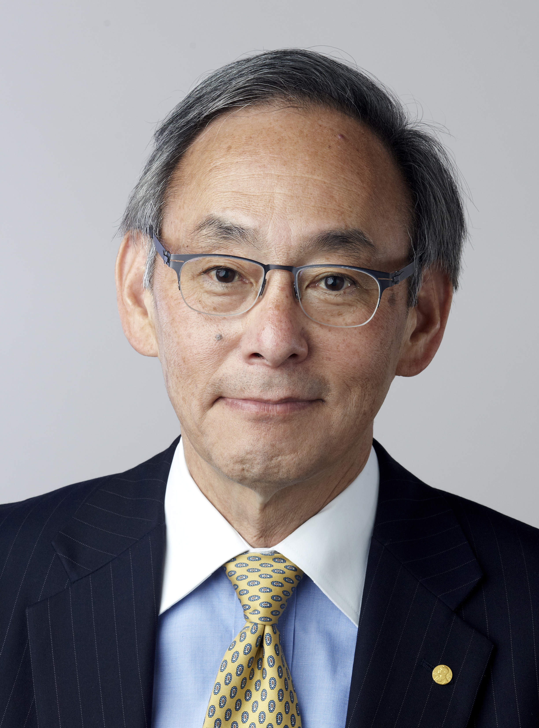
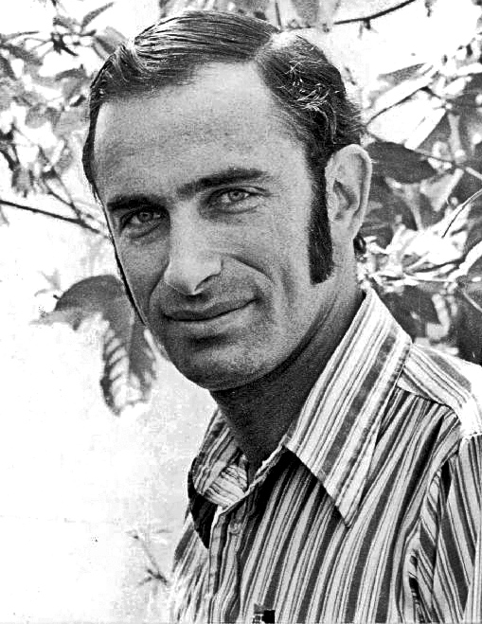
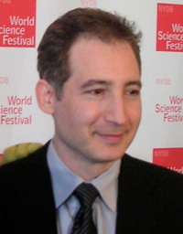
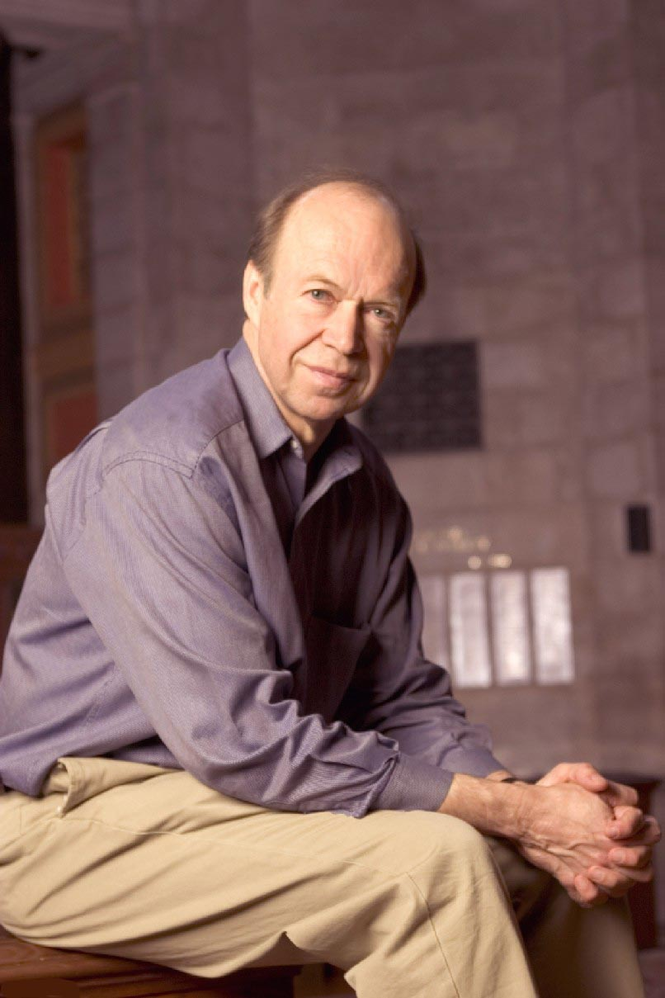
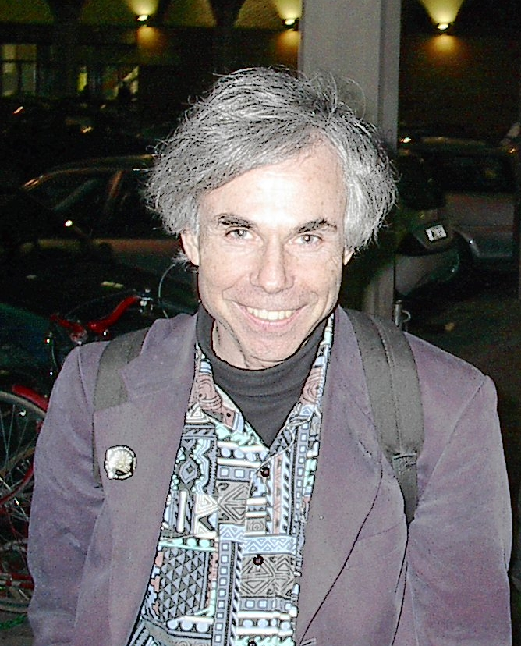
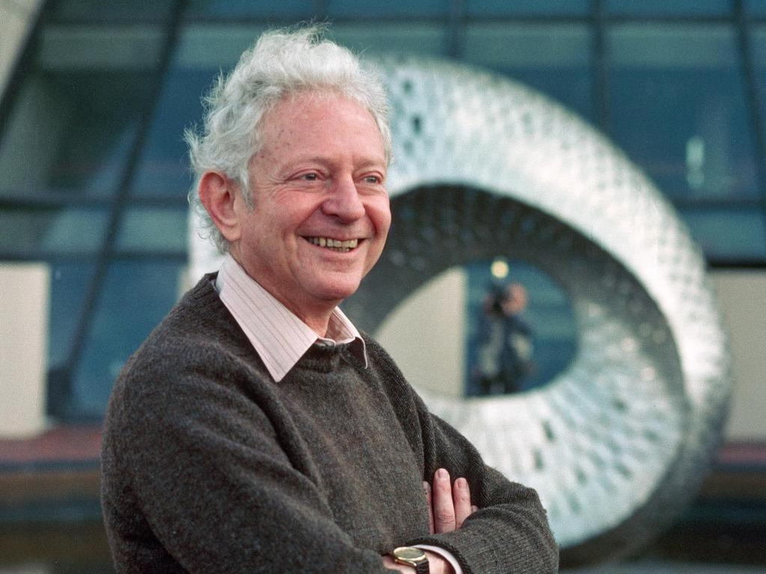
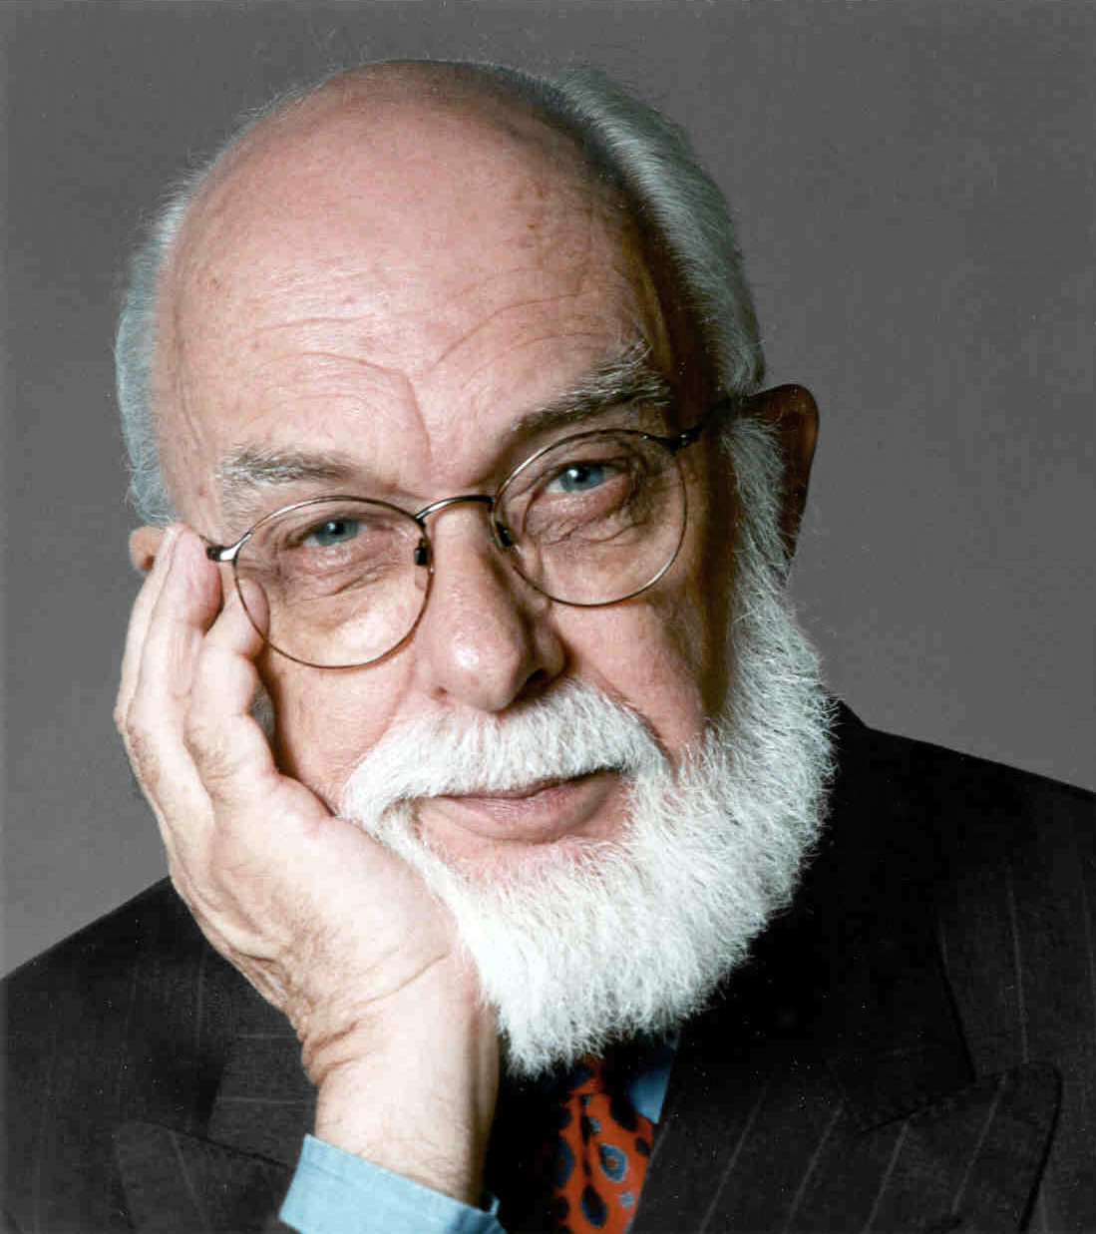
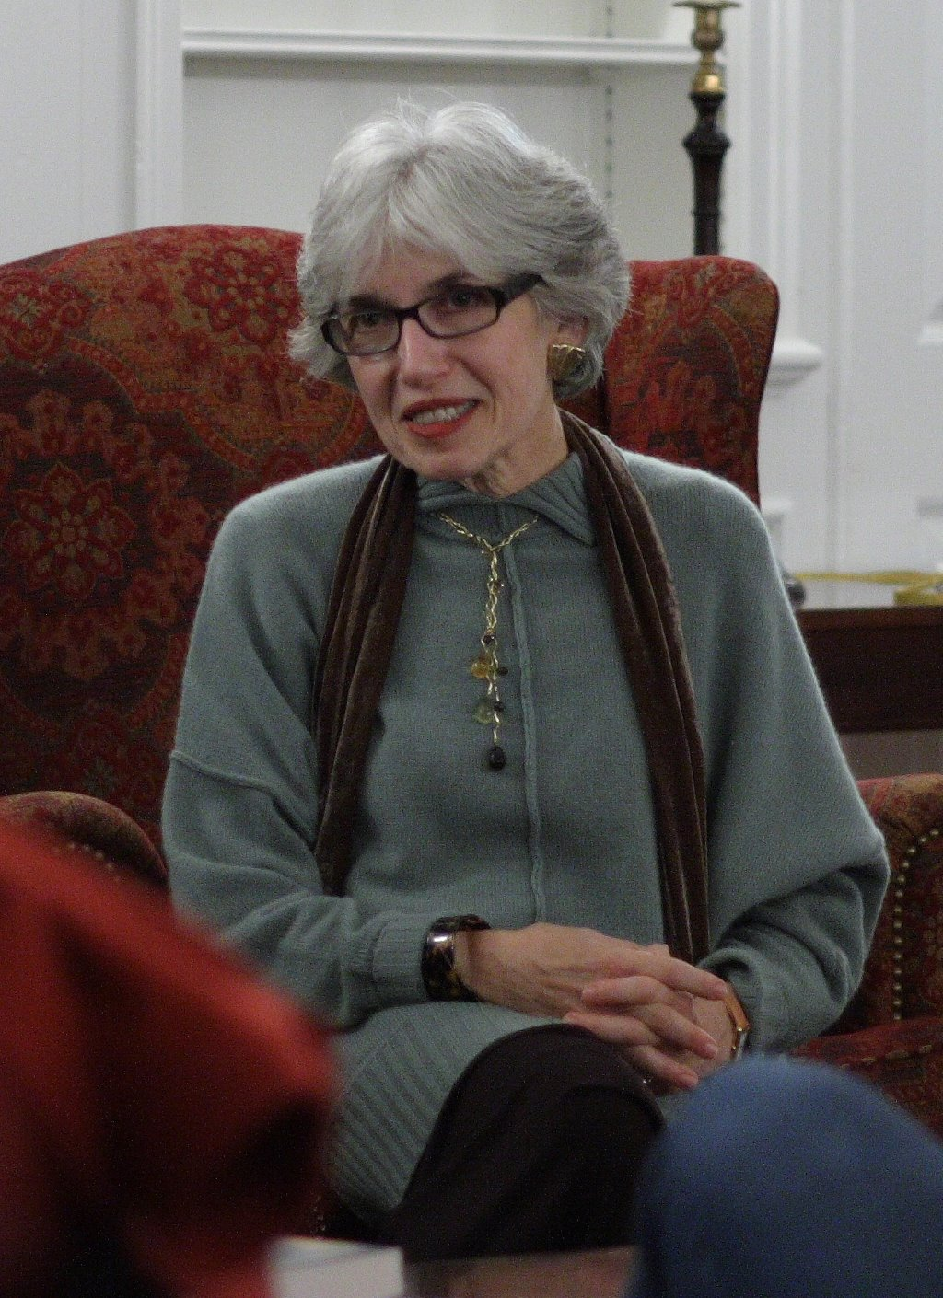
John Bahcall
Lester Brown
Stephen Chu
Paul Ehrlich
Brian Greene
James Hansen
Douglas Hofstadter
Leon Lederman
James Randi
Dava Sobel

Slide 6
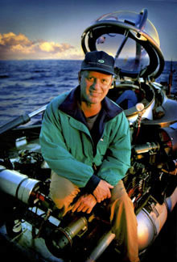
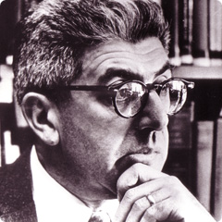
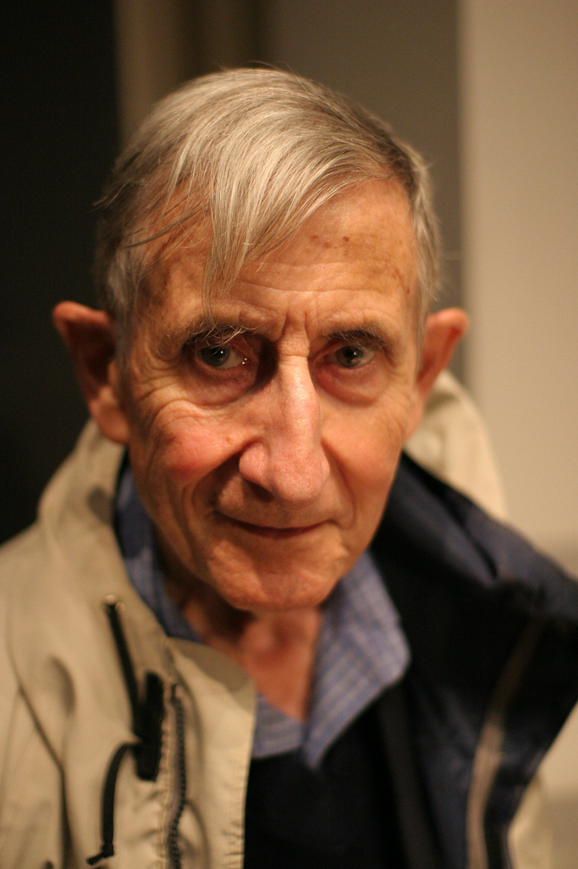
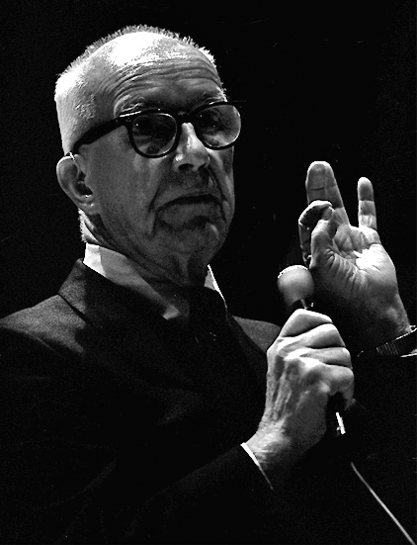
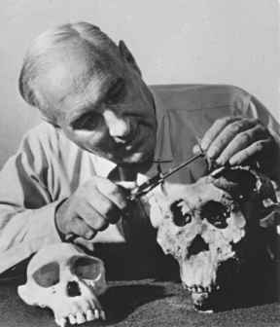
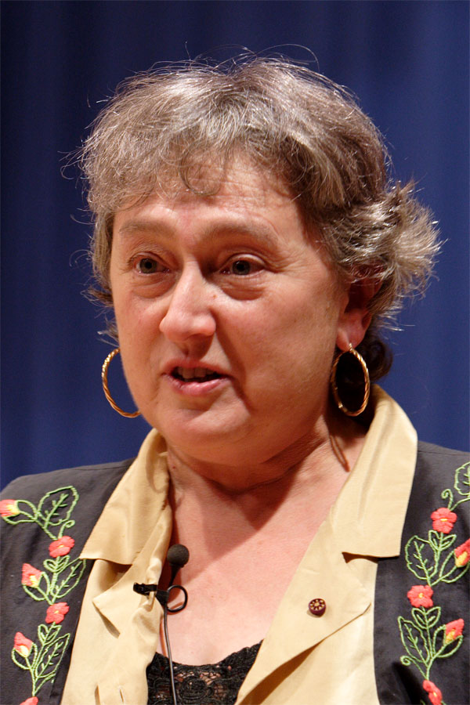
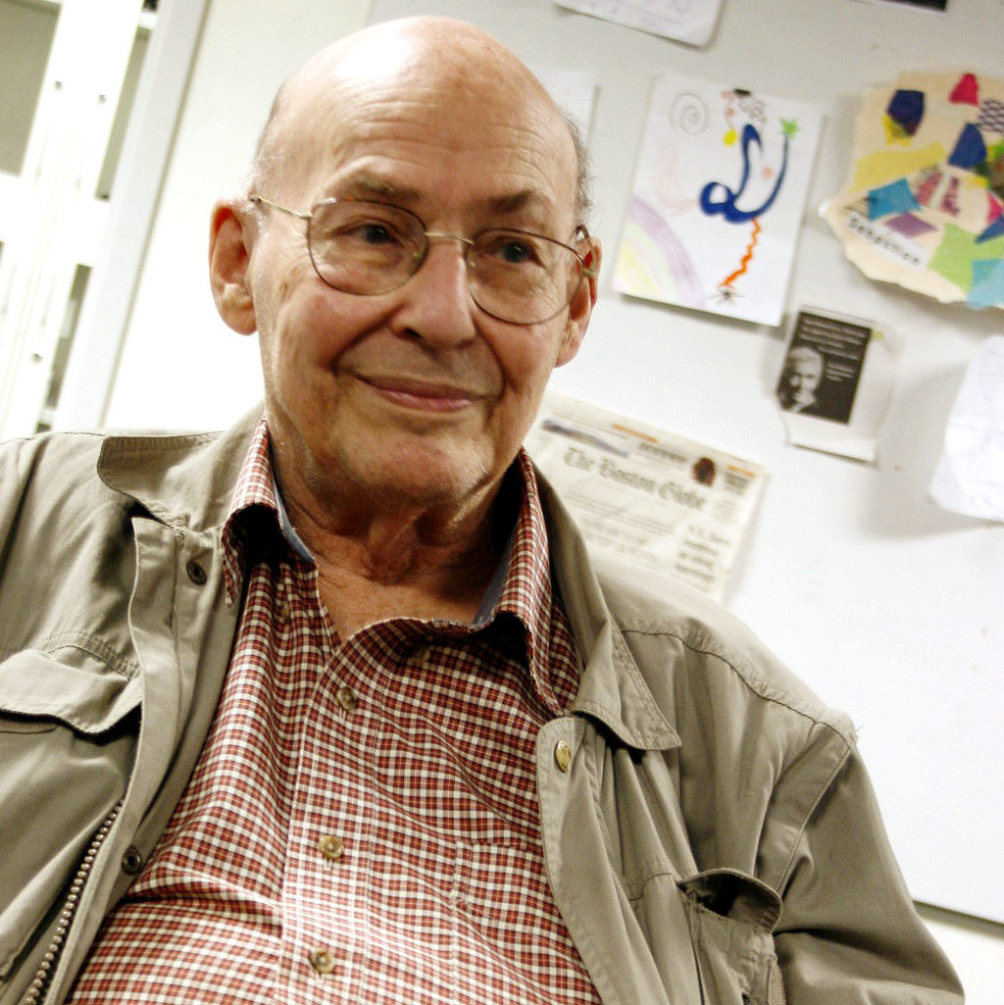
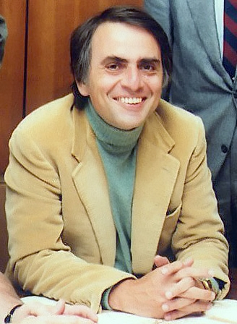
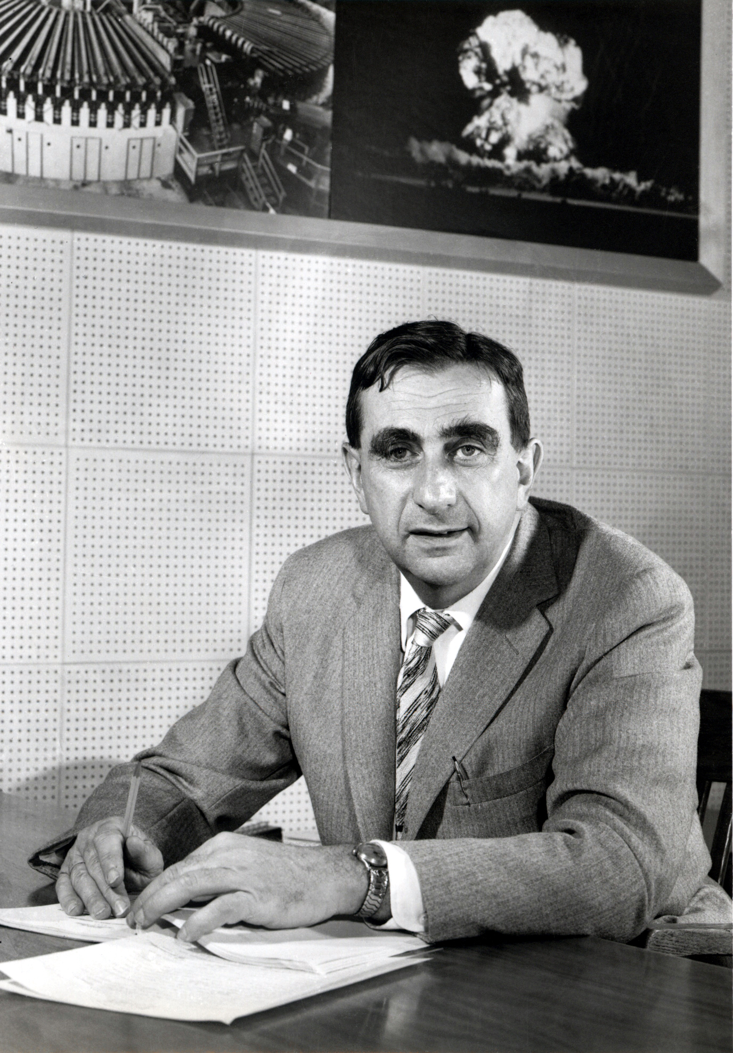
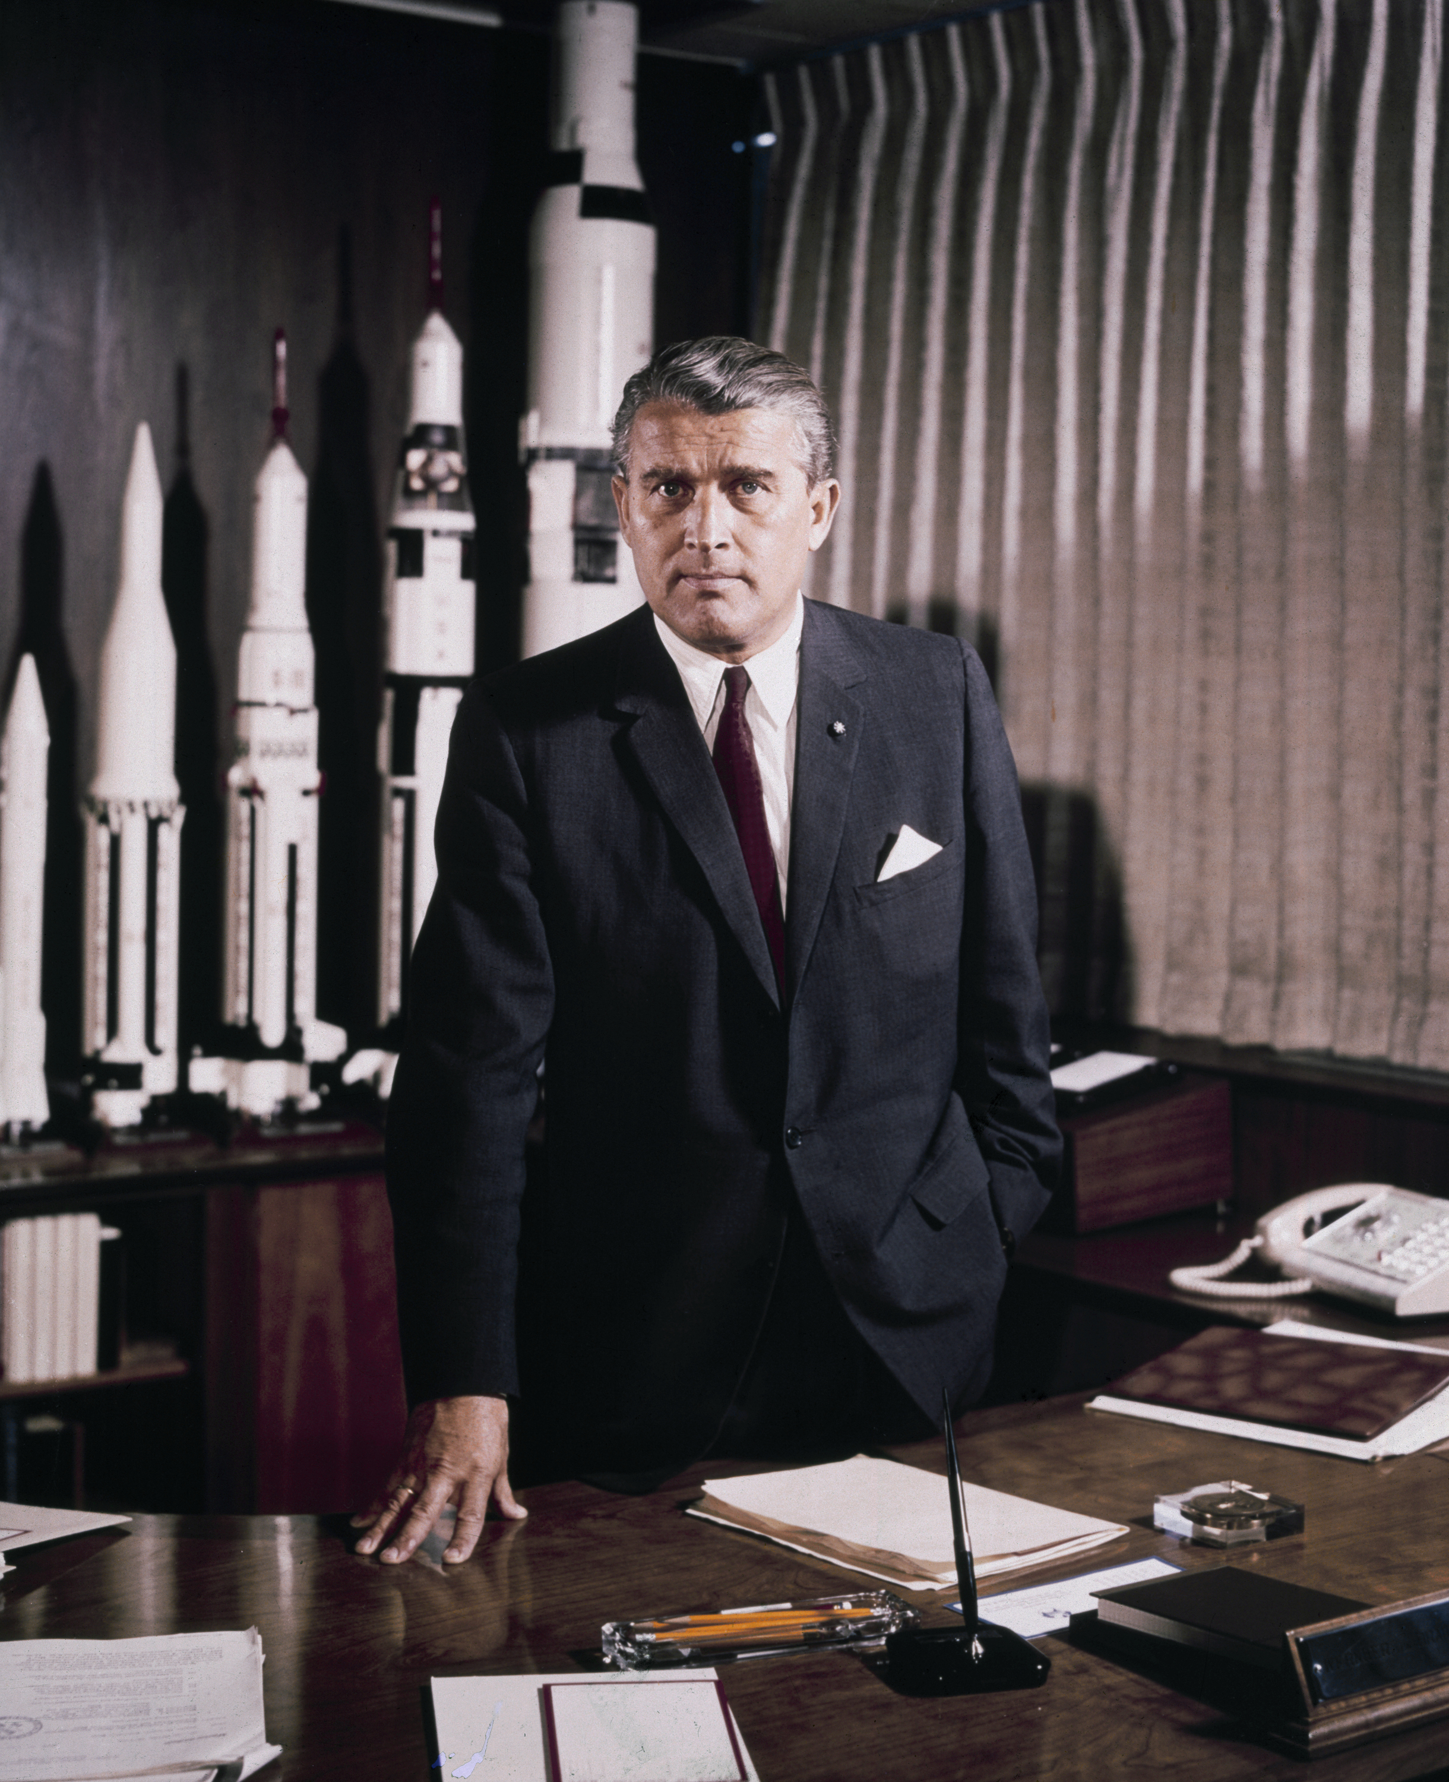
Robert Ballard
Barry Commoner
Freeman Dyson
Buckminster Fuller
Louis Leakey
Lynn Margulis
Marvin Minsky
Carl Sagan
Edward Teller
Wernher Von Braun

